Slide 1
NICE Bus
Bus Transit Committee Meeting
July 2025

Slide 2
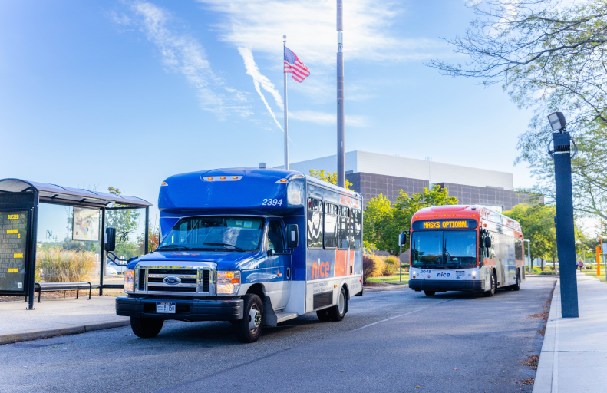

Agenda
2025 Operating Budget
Capital Plan Review
Q1 Score Card
Project Updates
Approval Request

Slide 3
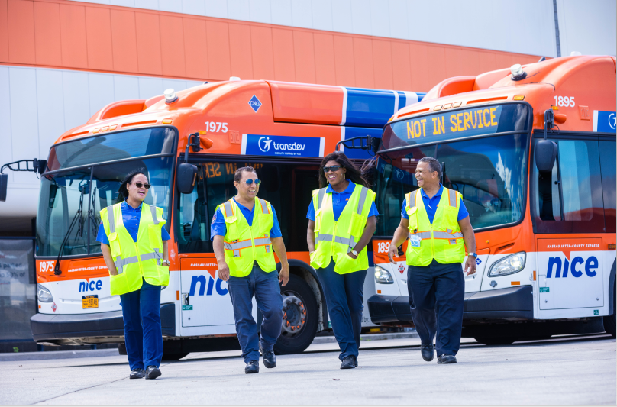
2025
Operating Budget
&
Capital Plan

Slide 4
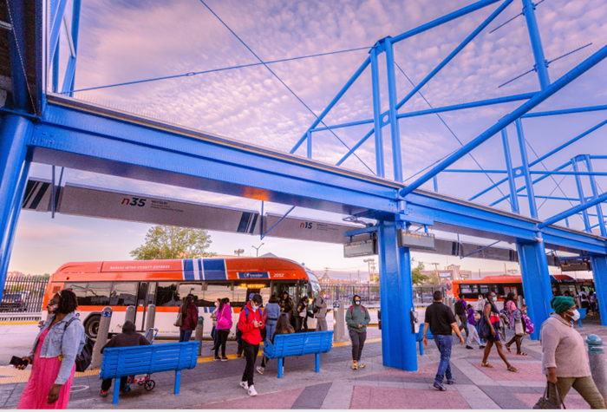
2025 Operating Budget: Service Hours
Paratransit
2024: 255,038 revenue hours
2025: 267,047 revenue hours
Fixed Route
2024: 922,124 revenue hours
2025: 891,251 revenue hours

Slide 5
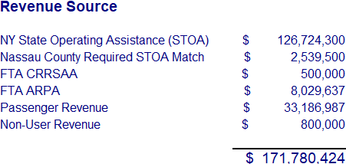
2025 Operating Budget: Funding
FEDERAL
COUNTY
OTHER
FARES
STOA

Slide 6
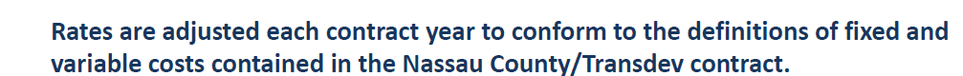
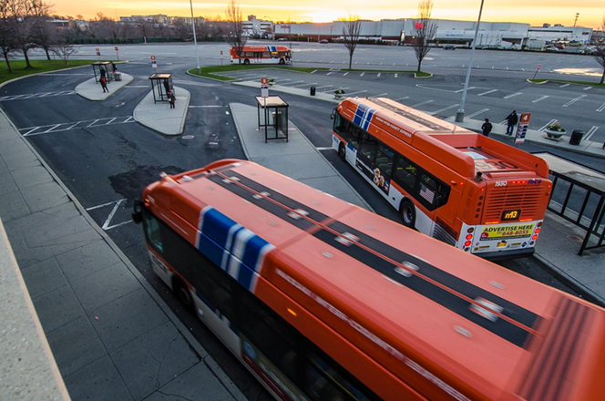
2025 Operating Budget: Rates
Monthly Fixed Fee:
    2024: $4.7M /Month
2025: $4.9M /Month
Fixed Route Variable Rate:
2024: $103/HR
2025: $107/HR
Paratransit Variable Rate:
2024: $62/HR
2025: $64/HR

Slide 7
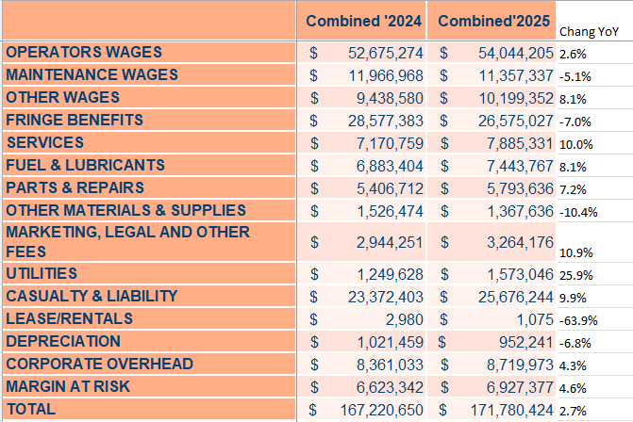
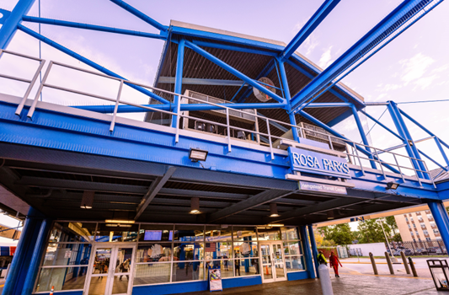
2025 Operating Budget: Detail

Slide 8
2025 Capital Plan
Capital Plan Highlights
Renovation at Rosa Parks - Hempstead Transit Center - COMPLETE
Battery electric bus charging stations – FINAL INSPECTION PHASE
15 new paratransit vehicles - COMPLETE
41 new CNG buses - COMPLETE
CNG fuel island upgrade – IN PROGRESS
Facility upgrades (exhaust system & methane detectors) – IN PROGRESS
OMNY implementation – IN PROGRESS

Slide 9
2025 Capital Plan

Slide 10
2025 Capital Plan

Slide 11

2025 Title VI Program Plan
“No person in the United States shall, on the ground of race, color, or national origin, be excluded from participation in, be denied the benefits of, or be subjected to discrimination under any program or activity receiving Federal financial assistance.”
A Title VI Program is a set of policies, procedures, reports, and assurances that demonstrate how NICE Bus & Able-Ride complies with Title VI requirements. This program must be developed, maintained, and submitted (typically every 3 years), to the Federal Transit Administration (FTA).
A Title VI Program refers to the formal plan and documentation that a recipient of federal funds creates to ensure compliance with Title VI of the Civil Rights Act of 1964.

Slide 12
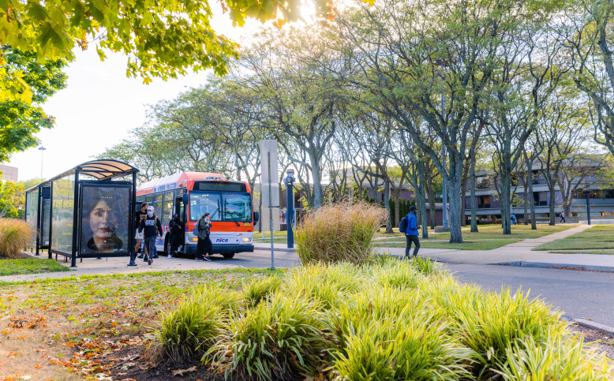
Q1 Score Card
&
Service Updates

Slide 13
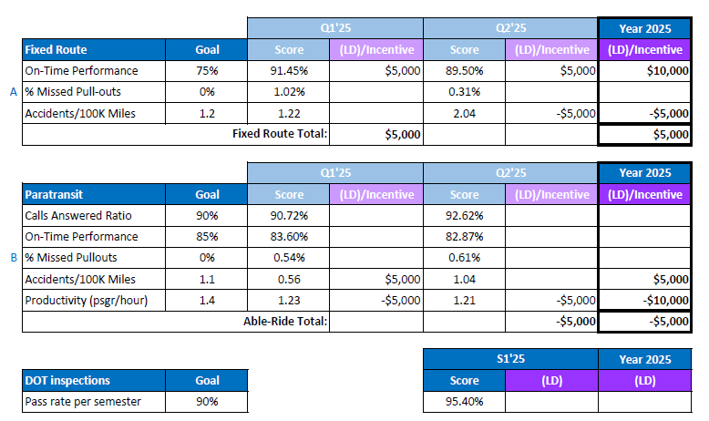
Score Card: Q1 & Q2 2025

Slide 14
Service Updates: Q1/Q2-2025
System wide time point adjustments to better align with LIRR Spring/Summer service schedule
MINI Syosset Pilot service discontinued
n1, n6/6X, n22/22X, n24 & n26 relocated new Jamaica Bus Terminal on 90th btwn 168 St & 169 St
n1 Weekday extension to UBS Arena discontinued
n21 Some weekday peak trips only travel Glen Cove-Roslyn, transfer to n20H for service to/from Great Neck; n21 & n27 schedules coordinated to provide 30min all day frequency between Glen Cove and Northern Blvd
n22X Express stops added at Hillside Ave & Herrick’s Rd
n25/58 Weekday trips separated into n25 and n58 trips (as previous) weekend trips still combined
n54/55 Trips will bypass Sunrise Mall; will stay on Old Sunrise Hwy to/from Amityville Station
n79X Pilot express service discontinued
n88 Jones Beach service June – Oct
LiveNation has chosen not to sponsor concert service for the 2025 Northwell Jones Beach Thearter season

Slide 15
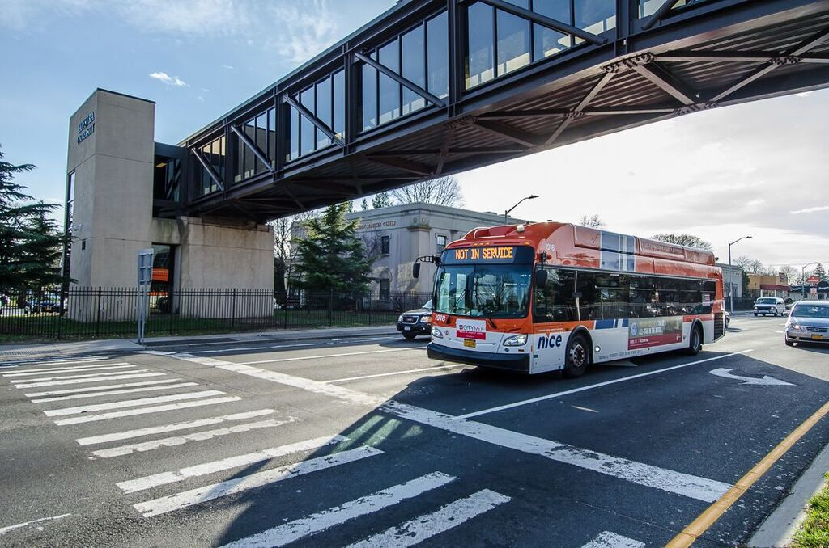
Request for Approval: 2025
2025 Operating Budget
2025 Capital Program
2025 Title VI Program
On-Line Trip Management

Slide 16
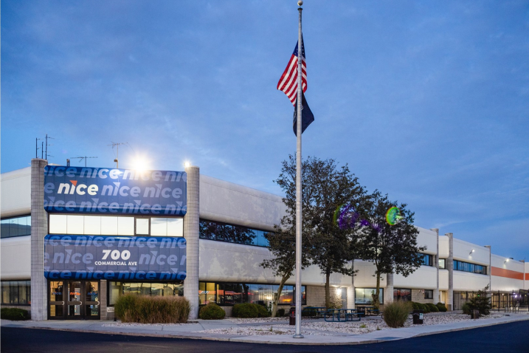
Thank you

