Slide 1

TRANSIT ACCESSIBILITY ADVISORY COMMITTEE (TAAC)
NASSAU COUNTY
March 17th, 2026 • 6:30 pm

Slide 2
AGENDA
I. Call to Order by Hari Dhoundiyal
Tuesday, March 17th, 6:30 pm
II. Action Items by Hari Dhoundiyal
• Introduction of Members
• Approval of Minutes
III. NICE Update by Erika Richards
IV. Review of Call Center Statistics
by Mildred Altidor
V. Service Review by Inmer Hernandez
VI. Committee Member Comments
VII. Adjournment by Hari Dhoundiyal

Slide 3
II. Introduction by Hari
Action Items:
• Introduction of Members
• Approval of Minutes

Slide 4
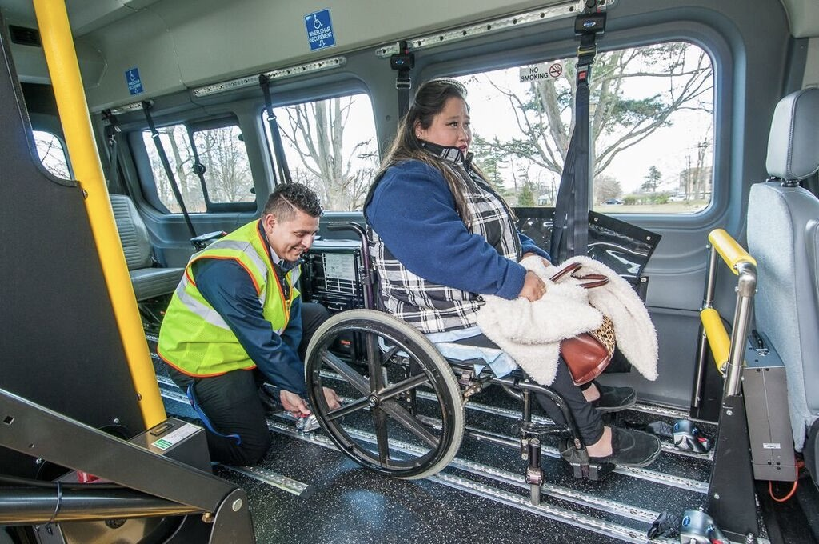
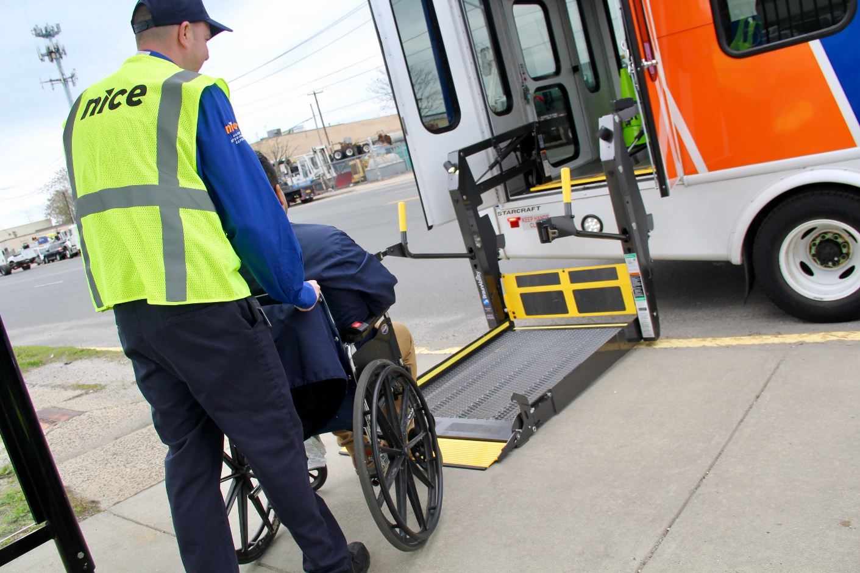
III. Presentation by NICE
Presented by
Erika Richards
• Service Updates

Slide 5

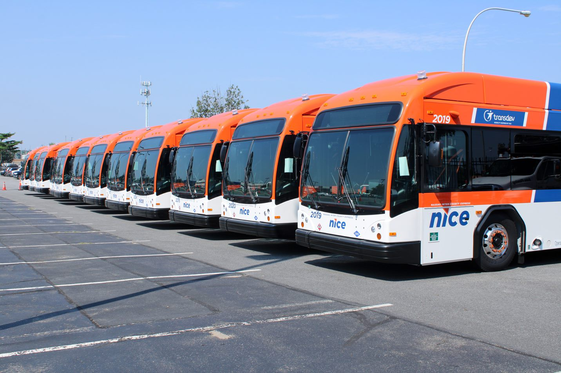
2026 fixed route OTP for February finished at 91%.
Winter Schedules started Feb.1st with little from our current Fall schedule.
June 2 & 3rd 2023

Slide 6
Review of Call Center Statistics &
Service Reports
Mildred Altidor
V. Call Center Statistics

Slide 7

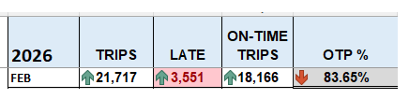
February 2026
Call Center Statistics
Average On Time Performance

Slide 8
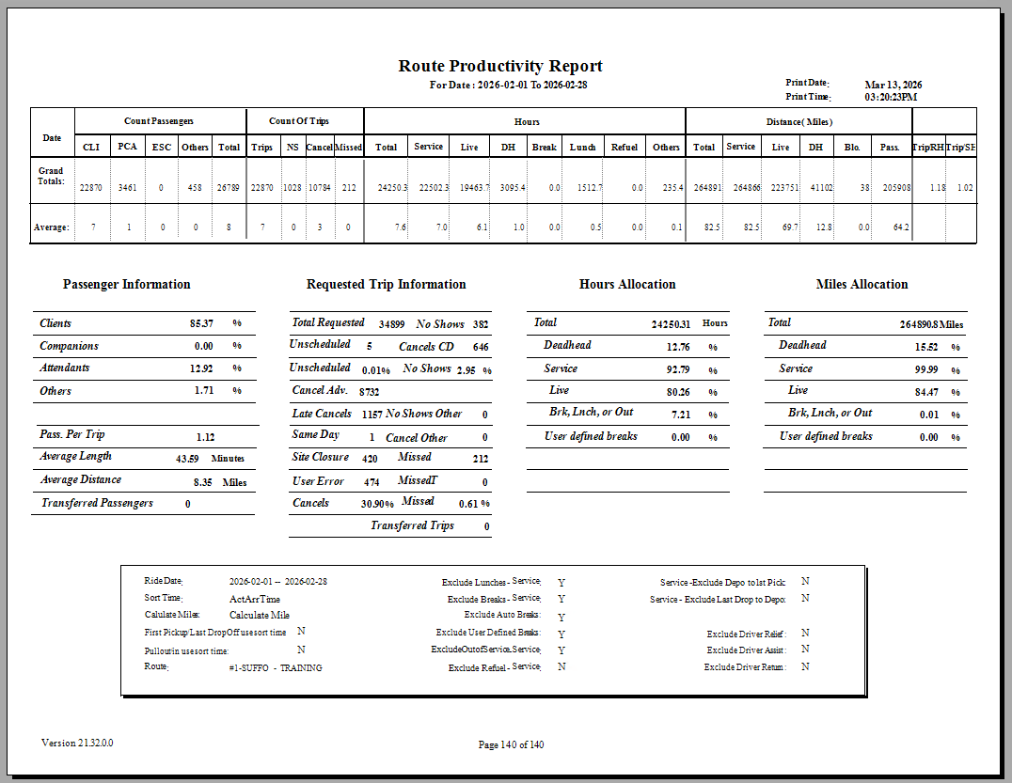
VI. Performance Stats February 2026

Slide 9
VII. Committee Comments
Questions/Comments?

Slide 10
VIII. Adjournment
Motion to Adjourn
Next Meeting:
Tuesday, April 21st, 2026

Slide 11
Thank you for
participating.
Stay Safe!

